Slide 1
WELCOME
2023 AF GENDER WEBINAR

Slide 2

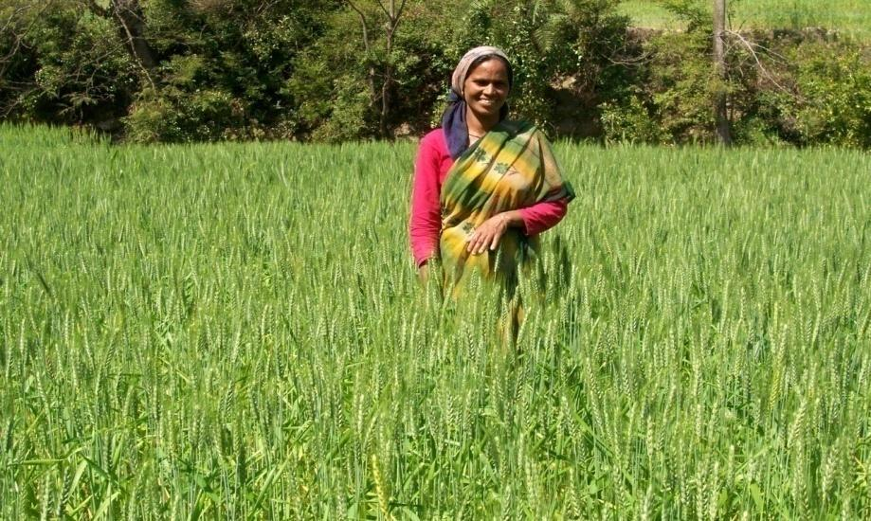
Webinar: Integrating a gender-responsive approach into AF portfolio
Adaptation Fund

Slide 3
Presentation
Introduction and objective of AF Gender Webinar
Reporting gender progress in the PPR
Compliance to AF GP in project proposal development
Q&A Session
IE Panel
1
2
3
4
5

Slide 4
1. Introduction & objective of AF Gender Webinar

Slide 5
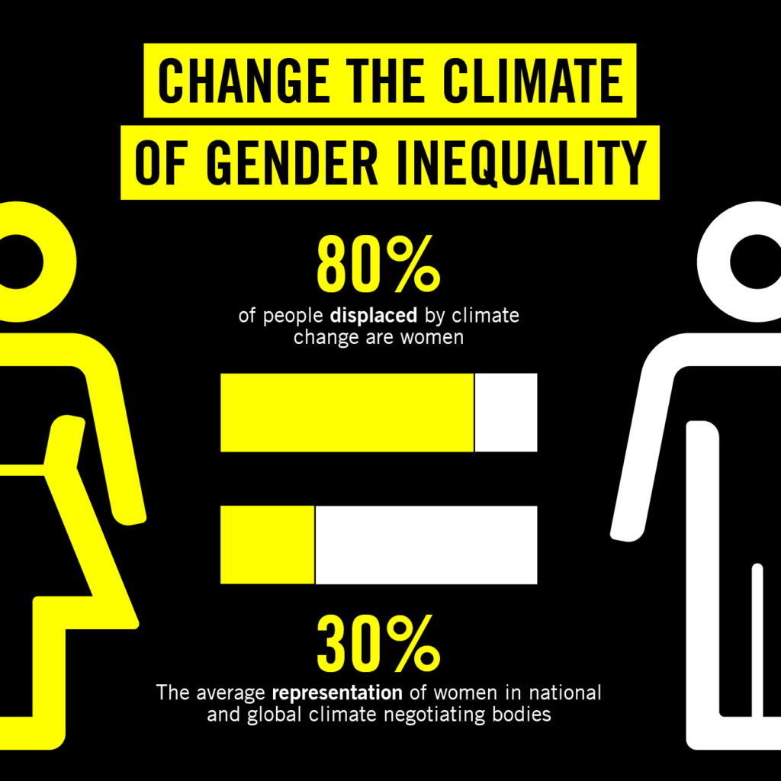
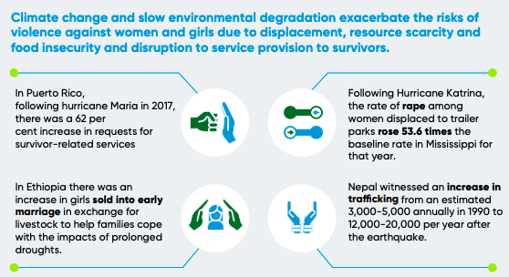
What is gender-responsive adaptation? And why it is important?
Source: UNWOMEN, 2022
Source: Amnesty International, 2021

Slide 6
What is gender-responsive adaptation? And why it is important?
Why is gender-responsive adaptation important?
Diverse factors (age, sex/gender, poverty level, refugee status) affect the capacity to adapt to climate change. These conditions often intersect and can exacerbate vulnerability.
Our current global system –with high rates of inequality, patriarchal structures and systemic barriers- contributes to an overall higher risk of women experiencing harmful effects of climate change.
Women are more likely to experience the adverse effects of climate change than men: they constitute most of the world’s poor and are often directly dependent on threatened natural resources.
What does it mean to implement a gender-responsive approach in adaptation?
A Gender-responsive approach seek to actively promote gender equality, involving specific actions to empower women in their households and communities, as well as broader political and planning processes.
If focuses on 3 areas: i) recognition of gender differences; ii) equitable participation and influence in decision-making; and iii) access to financial resources and other benefits.

Slide 7
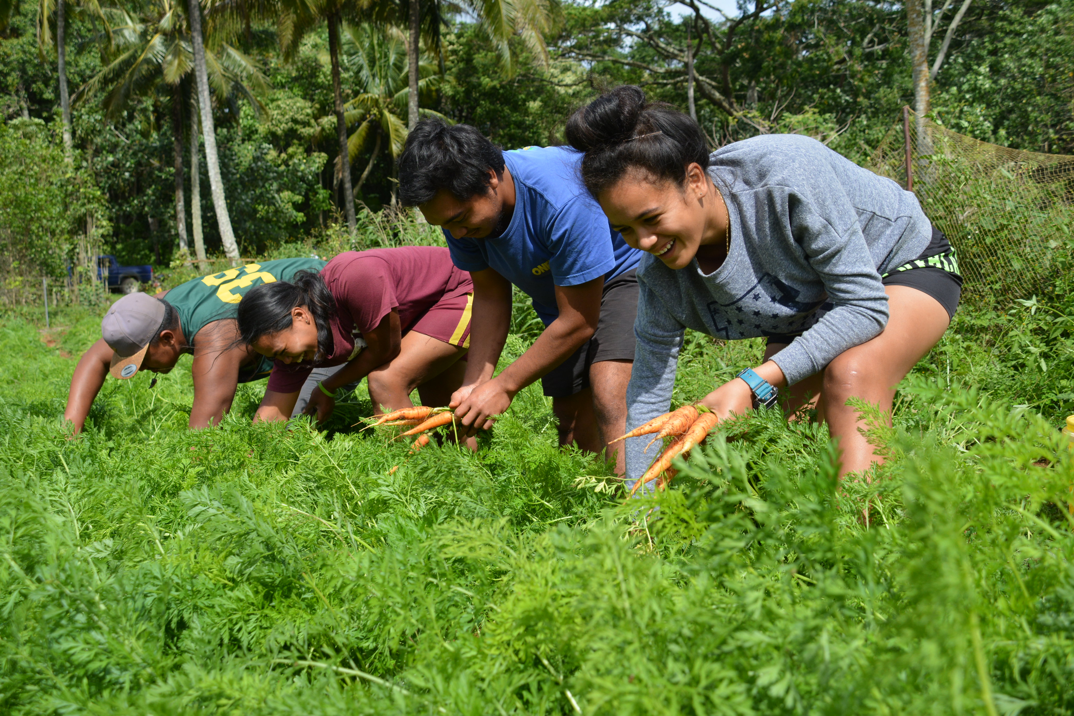
AF Gender Policy
Goal: To ensure that AF resources, services and operations
Include a gender-mainstreaming approach &
Contribute to the goal of gender equality & empowerment of women and girls
- Ensure the equal opportunities for access to AF resources
Intersectionality Approach
“Do no harm” + “Do good”
Gender-responsive (towards gender-transformative)

Slide 8
II. Compliance to AF GP in project proposal development

Slide 9
AF GP Requirements
Stakeholder consultation (para. 17)
Gender Analysis / Gender Assessment (para. 16)
Gender-disaggregated indicators (para. 16)
Gender Action Plan / interventions (para. 16)
Allocation of resources - gender-budgeting (para. 26)

Slide 10
A. Gender-responsive Stakeholder consultation
Good practices identified:
💡 Presence of gender experts
🎯 Quotas to ensure female participation
🌎 Inclusion of different gender groups (indigenous people, youth, refugees)
⏰ Flexibility for time and location (virtual formats)
To be documented in Proposal (PART II, Section H)
In an atmosphere free of manipulation and coercion
Begin early & Continuous process
Timely disclosure of relevant & adequate info
Non-discriminatory & Intersectional

Slide 11
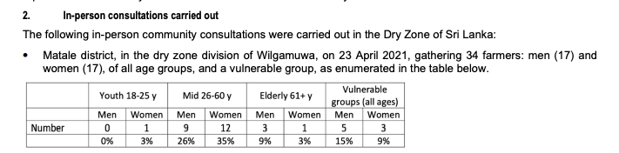
Gender-responsive Stakeholder consultation – example 1
Source: Strengthening Resilience of Vulnerable Communities in Sri Lanka and India to Increased Impacts of
Climate Change (India, Sri Lanka) [IE: WFP]

Slide 12
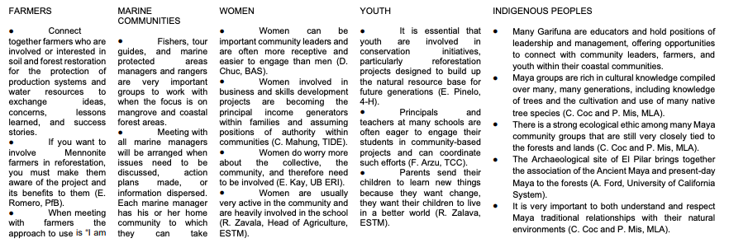
Gender-responsive Stakeholder consultation – example 2
Source: Use of Nature-based Solutions to Increase Resilience to Extreme Climate Events in the
Atlantic Region of Central America (Belize, Guatemala, Honduras) [IE: Central American Bank
for Economic Integration (CABEI)]

Slide 13
B. Conducting a Gender Analysis / Gender Assessment
Stakeholder consultation
Gender Assessment
Project proposal (design)

Slide 14
B. Conducting a Gender Analysis / Gender Assessment
Definition:
Analytical tool to systematically understand, identify and describe gender relations and differences in a specific context.
Objective:
It provides the necessary information to integrate the gender perspective into the project, by:
- acknowledging differences between and among women and men;
- ensuring that the different needs of women and men are clearly identified and addressed at all stages of the policy cycle;
- recognising that policies, programmes and projects can have different effects on women and men;
- seeking and articulating the viewpoints of women and men;
- promoting women’s participation and engagement
Key statistics
Do rural women have access to financial services?
Legal and policy framework
Does the country have a specific policy to encourage women’s participation in disaster risk management?
Social norms
Does the community believe that women should limit their participation in farming?

Slide 15
Gender Assessment – example 1
Source: “Regional Resilient Pastoral Communities Project –ADAPT”, Kyrgyzstan [IE: IFAD]
“426. (…) Women predominantly work in health and social services with 83.6% of the labour force being female; education 80.6%; and hotels and restaurants, 58.4%. In contrast, men dominate the highly paid technical sectors: men account for 84.4% of employees in the mining industry; 90.5% in the production of gas, electricity, and water; 89.3% in the transport and communication sector; and 96.5 in the building industry. The predominance of women in lower-paid sectors is reflected in the considerable gender wage differential, with women receiving on average just 75.3% of men’s earnings in 2016. This situation, coupled with a widening gender wage gap for women in employment, contributed to increased income poverty for women.
442. In the Kyrgyz Republic, climate change and environmental degradation are leading to deteriorating soil quality, water scarcity, and other phenomena such as floods, landslides and mudflows, which all have a disproportionate effect on women and girls. For example, women and girls are often the most affected by water shortages as they need access to water for tasks such as cooking, cleaning, and bathing children. In times of scarcity, they may restrict their own personal use, which can lead to psychological and physical discomfort during menstruation”.
Disaggregated data on:
  Gender roles
  Gender division of labor
Differentiated climate change impact on gender

Slide 16
Gender Assessment – example 2
Source: “Use of Nature-based Solutions to Increase Resilience to Extreme Climate Events in the Atlantic Region of Central America”, Belize, Guatemala, Honduras [IE: CABEI]
(Pag 110) “Specific efforts are needed to ensure that women and young girls are involved in conservation and restoration initiatives. An opportunity is presented as young women are more attracted to agricultural programs within high schools and community colleges than in earlier years. This notes a growing human capital in which the program will be able to rely on. Stigma still exists on women as society recognizes women working in farming as subsistence farming and backyard farmers but are not generally thought of as professional farmers. Nursery “farming” or horticultural production can provide opportunities for women to become involved in a new landscape restoration industry for Belize as income generators. Smallscale, backyard cover-crop systems can produce tree seedlings, bioremediation plants, and microbial solutions that fit into a model in which these products are sold to landscape restoration projects, providing a source of livelihood enhancement for the family without the woman having to leave home”.
(Pag 111) “The consultations revealed some initiatives that adopt a gender-based approach or that integrate gender considerations”.
Identifies opportunities for gender-responsive interventions
Focus on intersectionality (gender + age)
Analyzes how gender roles shape the project

Slide 17
Gender Assessment – example 3
Source: “Multisectoral Adaptation Measures to Climate Change in the South Oropouche River Basin for Flood Relief”, Trinidad and Tobago [IE: Development Bank of Latin America (CAF)]
“(Pag. 108) Gender mediates directly and consistently the experience of climate events, the impact on life and livelihood as a result of these events, and the capacity to adapt and to be resilient in response to these events.
(…) In the context of Trinidad and Tobago, like so many other places, any experience examined in terms of gender, must be understood as intersectional.
(Pag. 112) (…) Climate change impacts may be felt in the healthcare sector, significantly for women through their reproductive labour, the elderly, children, persons living with disabilities, the socially displaced, immigrants, etc.
A February 2021 Gender Analysis of Trinidad and Tobago, prepared by the UNDP, reinforces the extreme vulnerability to climate events and the compounded risks to vulnerable populations such as women, because they have less secure economic and that disasters increase the risk of reinforcing, perpetuating, and increasing existing gender inequalities.
(Pag. 113) In terms of livelihoods, agriculture, fisheries and commerce are the most relevant sectors of the economy in the SORB (project’s area). Regarding target groups in the project, in the County of St Patrick East there are 1,192 agricultural and livestock producers, from that 161 are women; in the district of Debe there are 460 farmers, including 62 women; and in the district of Princes Town there are 995 farmers, including 200 women.”
Gender disaggregated data
Focus on intersectionality vulnerability factors in addition to gender
Differentiated climate change impact on gender
Use of specific & recent information sources

Slide 18
C. Integrating gender into results framework
A gender-responsive project/programme results measurement framework:
Gender-responsive SMART indicators
  Qualitative: Number of communities who perceive that they benefit from effective, climate-resilient watershed management activities
  Quantitative: Proportion of women with improved access to financial resources (such as affordable loans) for climate-resilient products and services.
Mandatory
Optional
Age
Ethnicity
Others
Sex
Disaggregated data by:

Slide 19
D. Developing a Gender Action Plan
Impact
Output
Activity
Indicator
Outcome
Target
Timeline
Responsibility
Cost

Slide 20
Gender Action Plan - template
Impact statement: Increased food security for differentiated gender groups and gender sub-groups in the project/programme area through better access to improved climate-resilient agricultural inputs and extension services
Outcome statement: An estimated X number/increased percentage (against a baseline) of female subsistence farmers have improved their agricultural productivity in a climate-resilient way, taking into account traditional local and indigenous knowledge.
Output(s) statement: Indigenous female subsistence farmers in the project/programme area with improved access to climate-resilient agricultural inputs and extension services
Activity | Indicator | Target | Timeline | Responsibility | Cost
Outreach and awareness activities on climate-resilient agriculture target indigenous women | 5 new activities per year with the goal to reach 160 indigenous women (30% of which are from female headed households and other vulnerable sub-groups (e.g. widowed, minorities, disabled, the elderly) in total (baseline at implementation start: 0) | Expected number of indigenous women reached by project mid-term: 80 | Start by year 1 Complete by year 3 | Executing Entity | US$ 20,000

Slide 21
D. Developing a Gender Action Plan
Good practices to promote gender equality within projects:
Fostering women’s access to finance/loans to ensure income and develop businesses
Strengthening women’s participation and decision-making through establishment of quotas or women’s associations
Engaging men and communities to support social norms that empower women
Improving information and capacities for women’s resilience through extension services/trainings
Gender awareness trainings/methodologies to build capacities at local organizations and institutions

Slide 22
Gender Action Plan – example 1
Source: “Increasing the Resilience of Vulnerable Populations in Costa Rica by Scaling up Adapta2+” in Costa Rica [IE: Fundecooperación para el Desarrollo Sostenible]
The Gender Assessment is based on the findings of stakeholder consultation, which included 45% of women. Additionally, the consultation process adopted an intersectional approach, by focusing not only on women, but also indigenous groups, farmers’ organizations and rural communities.
Participants identified gender equity gaps by pointing out issues where women are at a disadvantage. The main social conditions of exposure to climate change for the regions identified by participants include: Families living in poverty, female-headed households, dependent family members, Women more exposed to unemployment, indigenous communities, and COVID-19.
Based on the gender assessment, a series of recommendations were provided, with additional contributions from the PIEG Technical Secretariat, in order to contribute to the reduction of gender gaps in climate change projects and programs supported by the institution.
The Gender Action Plan included a map of institutional actors by sector, identifying those public institutions responsible for adopting the gender perspective and actions recommended by the Plan.

Slide 23
Gender Action Plan – example 1
Source: “Increasing the Resilience of Vulnerable Populations in Costa Rica by Scaling up
Adapta2+” in Costa Rica [IE: Fundecooperación para el Desarrollo Sostenible]
Based on the recommendation, the project developed the following Gender Action Plan:
Approaches for Action | Objectives
Affirmative actions for GE | Ensure that institutions integrate the intersectional gender perspective through responsive and transformative gender initiatives; ensure the effective participation of women in their diversity in decision-making spaces for climate action.
Capacity building | Strengthen institutional capacities to accelerate actions in favor of gender equality in the face of the climate crisis; establish alliances between institutions that provide recognition of the capacities, experiences and knowledge of women in their diversity, focused on the development of sustainable productive activities and innovative techniques based on climate action.
Promoting employability and strengthening women’s economic autonomy | Ensure partnerships between institutions that facilitate technical advice to improve conditions and access to employability opportunities and the promotion of financial solutions for projects led by women in their diversity, focused on climate action for their economic autonomy
Climate risk management | Ensure that women in their diversity have tools and information to increase their resilience to the climate crisis and improve institutional and community conditions for gender-responsive integrated risk management
Knowledge management | Advance in the development of statistical and information gathering instruments that incorporate a cross-sectional gender perspective to systematize, analyze and make visible the differentiated impacts of the climate crisis on women in their diversity for national and municipal decision making.

Slide 24
Gender Action Plan – example 2
Source: “Use of Nature-based Solutions to Increase Resilience to Extreme Climate Events in the Atlantic Region of Central America” in Belize, Guatemala, Honduras [IE: CABEI]
Conclusions from the GA | Gender Action Plan | Affected project activities | Targets | Responsible
Need to ensure that women and girls at a community level participate in project activities | All management and labor positions are scheduled to be held by women | All activities under components 2 and 3 | At least 51% of management and labor positions held by women | EE
Need to strengthen the capacity of local women (and youth) in restoration practices | Training programs emphasize gender equity and awareness | All activities under component 4 | At least 51% of seed collection activities will be performed by women | EE
Women are at a great disadvantage in terms of income | Participation in project activities will be rewarded at the same level of compensation independent of gender. | All activities | Compensation will be at levels that are gender neutral | EE

Slide 25
E. Gender-responsive allocation of resources
Definition:
Tool to measure what amount from a project’s budget is spent on activities that address the differentiated identified adaptation needs of all gender groups and sub-groups.
Strategy used to influence budgetary processes and policies so that expenditures reflect the differences and inequalities between women and men in incomes, assets, decision-making power, service needs and social responsibilities for care.’
The AF Gender Policy states that AF-funded projects should allocate resources to ensure the integration of gender considerations in implementation, leading to gender equality in climate adaptation and the empowerment of women and girls (AF GP para. 26)

Slide 26
E. Gender-responsive allocation of resources
Why is it important?
It provides an analysis of how all areas of project spending impact differently on men and women.
It addresses whether project funding contributes to reduce gender inequality, leave gender equality unchanged or increase gender inequality.
It also creates more transparency and accountability by allowing for checks on whether the allocations for gender-specific activities are in line with project goals and mandates under the AF-GP.
It brings gender awareness into government policy, planning, budgeting and programming frameworks to improve the allocation and effectiveness of public spending for gender equality and women’s empowerment.

Slide 27
Gender-responsive allocation of resources – example 1
Project: “Adaptation to Climate-induced Water Stresses through Integrated Landscape Management in Bhutan”
IE: Bhutan Trust Fund for Environmental Conservation
EE: Department of Agriculture & Department of Forest & Park Services (Ministry of Agriculture and Forests) & Department of Engineering Services (Ministry of Works and Human Settlements)
Budget: US$ 9,998,955
The Project Document includes a GAP with a specific budget of US$ 58.4K which includes the following activities:
- Establish formal registration of
WUAs
- Training on water infrastructure, tools and technology
- Training on water governance
- Training to farmers on sustainable agriculture practices
- Recruitment of a Gender Specialist
- M&E of GAP
The budget hasn’t include the financial allocation of "general activities" that will be implemented, which avoids having a “full picture” of the total budget that really contributes to gender equality.

Slide 28
III. Reporting gender progress in the project performance report (PPR)

Slide 29
Reporting gender-responsive interventions
Gender Policy Compliance Section
Quality at entry
Quality during implementation and at exit
Implementation arrangements
Grievances
Focus on:
-> types of gender-responsive interventions
-> lessons learned and challenges
-> good practices / potential to scale up

Slide 30
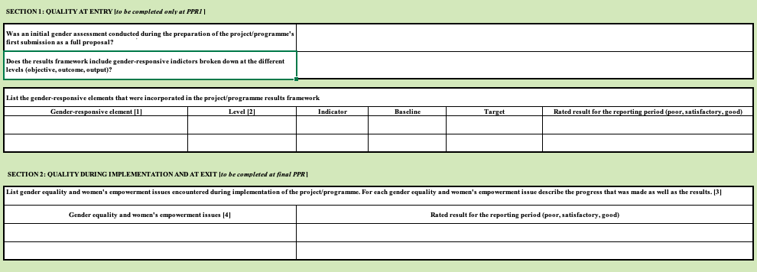
Reporting gender-responsive interventions

Slide 31
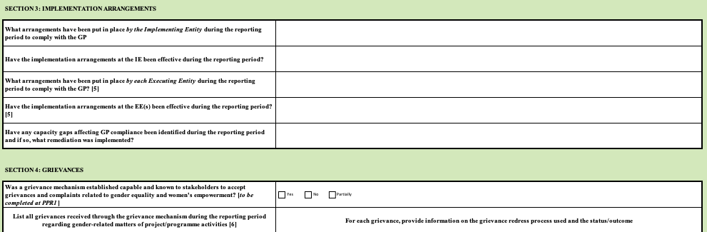
Reporting gender-responsive interventions

Slide 32
IV. Q&A Session

Slide 33
Relevant gender information & documents
AF Gender Policy and Gender Action Plan (2021)
Guidance Document for IE on compliance with AF GP (2022)
Study on Intersectional approaches to gender mainstreaming in adaptation-relevant interventions (2022)
Assessing progress: Integrating gender in AF projects and programmes (2020)

Slide 34
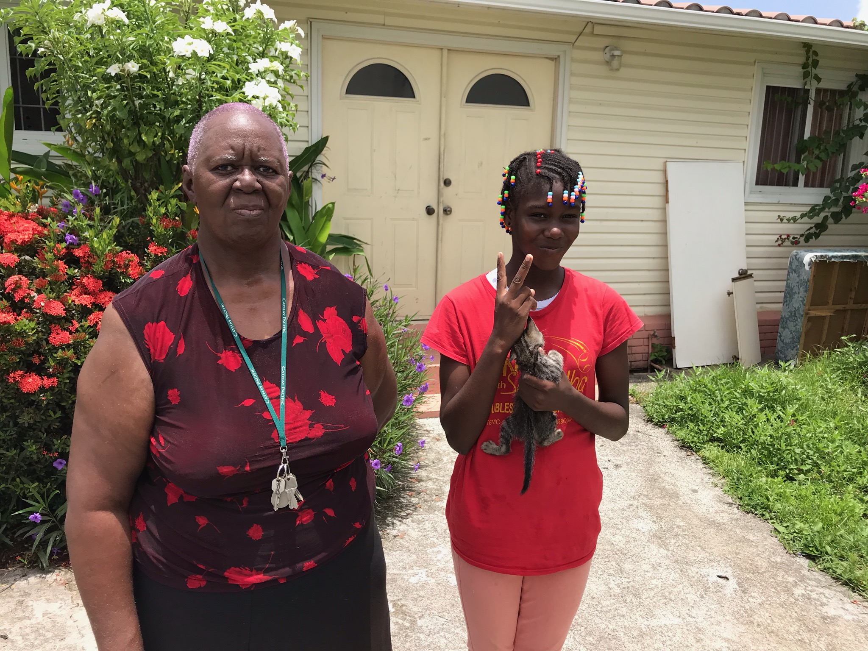




Young Hee Lee
Governance Specialist & Gender Focal Point
Adaptation Fund,
ylee12@adaptation-fund.org
Graciela Hijar
Gender Consultant
Adaptation Fund,
ghijarsantibanez@adaptation-fund.org
www.adaptation-fund.org
@adaptationfund
@adaptationfund
adaptationfund
adaptation-fund

