Slide 1

Overview of AF Accreditation process and requirements for a second NIE
Enhanced Direct Access, Costa Rica, 21 to 23 June, 2022

Slide 2


Background to the AF Accreditation Process
Ensures that applicant entities follow fiduciary and safeguard standards while accessing financial resources of the Adaptation Fund.
Applicants undergo an assessment for accreditation to make sure they adhere to sound accreditation standards and implement effective social and environmental safeguards to identify any project risks in advance, prevent any harm and improve the effectiveness and sustainability of results.
Follows a transparent and systematic process through an Adaptation Fund Accreditation Panel (the Panel) supported by the Secretariat.
Notes:
The revision of the re-accreditation process was approved by Decision B.34/3.

Slide 3
AF Accreditation portfolio to date
57 IEs accredited to date
34 NIEs, 9 RIEs, and 14 MIEs
16 out of this are NIEs (about 48%)
33 IEs have been re-accredited (58%)
10 accredited NIEs from LDCs; 7 accredited NIEs from SIDS; and 17 accredited NIEs from other developing countries
Recent Accreditations:
SPC
PKSF
CCCCC
Reinforces AF’s commitment to Direct access and the importance of country ownership and building national capacity in adaptation

Slide 4
AF Accreditation Process
Nomination
Application
Screening by the AFS
Review by the AP
AP Recommendation
Nomination: An entity that meets the accreditation standards is identified and nominated as a potential implementing entity by a Designated Authority (DA)
Application: Submission of accreditation application to the Secretariat together with the required supporting documentation to verify how an applicant meets the fiduciary standards and their commitment and ability to comply with the environmental and social policy and gender policy.
Screening by the AFS: To ensure that all the necessary information is provided. AFS follows up with the potential implementing entities to ensure that the application package is complete.
Review by the AP: The Panel reviews the application, identifies any questions and potential gaps and communicates directly with the applicant until it is ready to make a final assessment and recommendation.
AP Recommendation: Based on the Panel’s assessment and recommendation, the AFB approves recommendation for accreditation.
Notes:
The revision of the re-accreditation process was approved by Decision B.34/3.

Slide 5
Parties of the Accreditation Process
DA
App. IE
AFB sec
AP
AFB
Initial Review and Subsequent Reviews upon applicant's Response to questions and queries
Final Assessment Report and Panel Recommendations
Presentation of the Endorsement Letter
Application
Screening
Decision

Slide 6
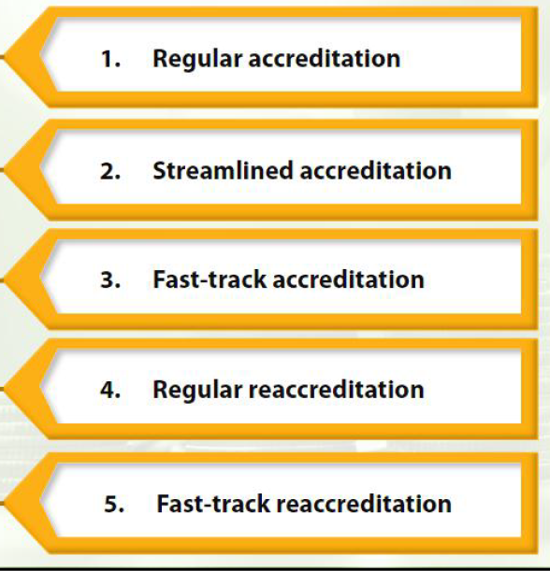
Accreditation modalities
Re-accreditation Process
An organization can change significantly in five-years and therefore the process of accreditation renewal must be commensurate with any potential changes to the organization.
Applicants are requested to describe any changes that have occurred since its accreditation with AF and provide the most up-to-date supporting documentation in compliance with the re-accreditation criteria.
It is important to start the process early - avoid a major gap between accreditation expiration and the granting of re-accreditation.
Accreditation Modalities
Accreditation is valid for a period of 5 years
Notes:
Ref. Document AFB/B.34/5. Let’s now go through the areas of review in regard to the fast-track re-accreditation process.

Slide 7
Accreditation modalities – cont’d
Regular Accreditation: Available to entities of all types, sizes, and risk profiles.
Streamlined Accreditation: Designed to support smaller entities access AF resources; typically available for applicants that execute or implement projects that cost up to USD 1 million; that have a staff of up to 25 members engaged in projects, and that have annual administrative expenses of up to USD 1 million.
Fast-track Accreditation: Available to all applicant entities that had been accredited by the GCF within a period of four years prior to the submission of the accreditation application to the Fund.
Regular re-accreditation & fast-track re-accreditation: Allow an entity to renew its accreditation status, either through the Regular Reaccreditation or Fast-Track Reaccreditation modality.
  Developed to provide the Panel with a systematic approach to review the sustainability of an applicant’s competencies under the fiduciary standards as well as its potential to address the criteria of the ESP and GP.
Notes:
Ref. Document AFB/B.34/5. Let’s now go through the areas of review in regard to the fast-track re-accreditation process.

Slide 8
Financial and Management Integrity
Financial Statements and External Audit requirement
Internal Control Framework
Internal Audit/Assurance and Oversight arrangements
Preparation of Business plans and budget
(Criteria 2-4)

Slide 9
Internal Control Framework
Elements that require IE applicant elaboration:
Accountability: evidence/confirmation that the internal control framework is operating satisfactorily
  Supported by periodic review of the effectiveness of the internal control elements, i.e., internal control reviews carried out by management or by the internal and external auditors.
Payment and Disbursements: The application and supporting documents should include a demonstration of the organization’s capability to ensure that all payments and disbursements, with a particular reference to projects, are properly checked and made only for bona-fide/ approved purposes.
Required basic documents and information are as follows:
  A description of the disbursement system and procedures, including the most important steps in processing payments for both projects and other expenditures;
  A description of authorized signatories in the payment and disbursement system; and
  Evidence of a recent audit, or similar review, related to the disbursements and payments function of projects.

Slide 10
Institutional Capacity
Project Closure and Final Evaluation
Project Preparation and Appraisal
Project Monitoring and Evaluation
Project Implementation Planning
Procurement
(Criteria 5-9)

Slide 11
Transparency, Self-investigative
Powers, Anti-corruption measures and mechanism to address E&S and gender complaints
Policies and Framework and capacity to deal with fraud, corruption and other forms of malpractice
Mechanism to deal with complaints on environmental and social harms caused by projects
Commitment by the entity to apply the Fund’s Environmental & Social and Gender policy
(Criteria 10-12)

Slide 12
Commitment to abide by Fund’s ESP and GP
The ESP and GP is operationalized at the Fund level at two key stages:
  During the process of accrediting Implementing Entities (IEs); and
  During the process of project and programme review
During the accreditation process, the Accreditation Panel will assess whether the IE has the capacity and commitment to address environmental and social risks, and whether a grievance mechanism is available in order to either be accredited or to maintain accreditation.
The IEs are responsible for the environmental and social risk management of projects/programmes under their supervision.
The IE applicant demonstrates, in a written/official statement issued at the highest managerial level, its commitment to abide by the ESP and GP in all projects/programmes funded by the Fund.

Slide 13
AML/CFT requirements
Anti Money Laundering (AML) and Countering the Financing of Terrorism (CFT) :“examples of supporting documentation” related to the “internal control framework”, “procurement” and “policies and framework to deal with financial mismanagement” criteria in the accreditation application form (Criteria 3 (b); 5(a); 10 (c))
The documentation needed to meet these requirements include:
Policies and procedure related to anti-money-laundering/countering the financing of terrorism;
Screening system which documents all individuals and/or organizations before the entity transfers money to them; and
Decision-making process that the entity follows when it identifies risks related to any individuals and/or organizations.

Slide 14
Relevant Resources
Regular Accreditation Application Guidance document (English, French and Spanish)
Fast-track Accreditation Application Guidance document (English, French and Spanish)
Regular Reaccreditation Application Guidance document (English, French and Spanish)
Fast-track Re-accreditation Application Guidance document (English, French and Spanish)
Guidance on Accreditation Standards (English, French and Spanish)
The Re-accreditation Process (English, French & Spanish)
AF e-Learning course on Direct Access (English, French and Spanish)
AF Environmental and Social Policy (English & Spanish; French under translation)
AF Gender Policy (updated in March 2021) (English & Spanish; French under translation)
NIE Accreditation Toolkit (English & French)
Information Note for Designated Authorities for IE nomination

Slide 15
Second NIE nomination
At the Thirty-sixth AFB Meeting (April 2021) through Decision B.36/42
Having considered the analysis contained in document AFB/B.36/5, the Adaptation Fund Board (the Board) decided:
(a) To enable the accreditation of up to two National Implementing Entities (NIEs) per country for eligible developing-country Parties, and to request the secretariat to reflect that change in the Operational Policies and Guidelines (OPG) and to submit the revised OPG for consideration by the Board at its thirty-seventh meeting;
(b) To strongly encourage countries to make use of the direct access modality of the Adaptation Fund in order to enhance national capacity and country ownership, including, whenever possible, through the accreditation of NIEs and the submission of projects through the same.
The decision enables countries to nominate and accredit up to two national implementing entities (NIEs) per country
It encourages all developing countries, including those that do not yet have NIEs, to make use of the Direct Access modality to bring potential new entities forward for accreditation and to develop adaptation projects through the modality.
Notes:
Ref. Document AFB/B.34/5. Let’s now go through the areas of review in regard to the fast-track re-accreditation process.

Slide 16
THANK YOU
Notes:
Ref. Document AFB/B.34/5. Let’s now go through the areas of review in regard to the fast-track re-accreditation process.

