Slide 1


The Accreditation Process
November 10-12
Panama City, Panama

Slide 2
Access modalities
NIE, RIE and MIE shall:
Meet the fiduciary standards established by the AFB:
  Financial management and integrity
  Institutional capacity
  Transparency, self-investigative powers and anti-corruption measures
Bear full responsibility for the overall management of the projects and programmes; and
Carry out financial, monitoring and reporting responsibilities.

Slide 3
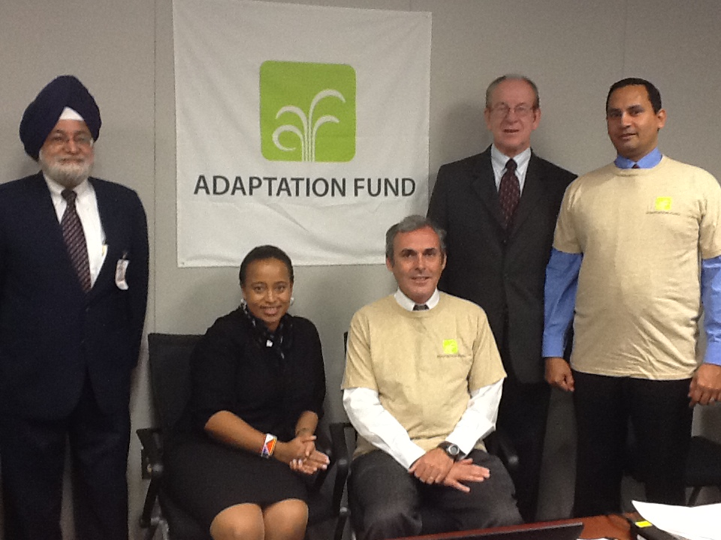
Accreditation Panel

Slide 4
Access modalities: the Accreditation Process
Step 0: The government appoints a Designated Authority. The DA must endorse the accreditation application of Implementing Entity and all IE project/programme proposals.
Step 1: Submit application:
  Description of how the organization meets the specific required capabilities
  Attachment of supporting documentation
Step 2: Accreditation Panel Reviews Application.
Step 3: Panel can request additional information/clarification from organization.
  Might suggest to Board that an on-site visit is required
  Might suggest that technical support needs to be provided to an applicant to improve its capacity in order to attain accreditation
Step 4: Panel makes recommendation to AF Board.
Step 5: AF Board makes final decision on accreditation of entity

Slide 5
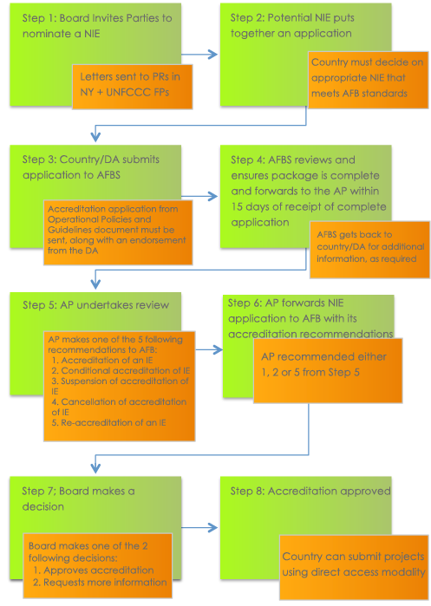

Slide 6
Implementing Entities
6 National Implementing Entities accredited:
  Centre de Suivi Ecologique (Senegal)
  Planning Institute of Jamaica (Jamaica)
  Agencia Nacional de Investigación e Innovación (Uruguay)
  Fonds national pour l'environnement (Benin)
  South African National Institute for Biodiversity (South Africa)
  Protected Areas Conservation Trust (Belize)
1 Regional Implementing Entity
    Banque Ouest Africaine de Développement (BOAD)
9 Multilateral Implementing Entities accredited:
  The World Bank, ADB, AfDB, IADB, UNDP, UNEP, IFAD, WFP, WMO
Swift accreditation process: can be done in 3 months

Slide 7
Understanding the Accreditation Toolkit and its use

Slide 8
Accreditation Toolkit
This is a practical “How-To” guide, for countries to assist them in the accreditation process for their National Implementing Entity (NIE ).

Slide 9
Accreditation Toolkit
This toolkit includes a number of tools and resources for countries to use when they start the accreditation process for a NIE, including forms, practical case studies and step-by step-assistance to support a successful conclusion to the accreditation process. This toolkit is primarily intended for use by the institutions and staff of:
1. Designated Authority
2. Potential NIEs
3. Government officials
4. Civil society
5. Multilateral agencies (that assist with dissemination of information on the accreditation process).

Slide 10
Accreditation Toolkit
Two interactive modules have been developed to help entities become accredited with the Adaptation Fund.
The first can be accessed through www.adaptationfund.org/NIE/toolkit, and the second through a USB flash drive provided by the Adaptation Fund Board Secretariat.

Slide 11
Accreditation Toolkit
Highlights of the Toolkit
Assist countries to understand the accreditation process ;
Guide countries step by step to prepare and submit an accreditation application;
Provide online assistance on standards required by the Adaptation fund;
Provide case studies and sample review sheets from completed and ongoing accreditation applications;
Provide access to a number of tools to ensure successful completion of the accreditation process of an NIE.

Slide 12
Accreditation Toolkit
Easy Navigability;
One stop shop for all reference material for accreditation of an NIE;
Easy roadmap to guide applicants through a self-generated checklist to ensure all supporting documents are attached;
Explanation of basic requirements and terms;
An online application form and checklist for ease of submission;
Document checklist to ensure all required documents for the application are attached with a warning feature if documents are missing;
Offline, electronic version will be available through USB Flash Drive.

Slide 13
Accreditation Toolkit
How to get started
1. Type in www.adaptation-fund.org/NIE/toolkit in your
Internet browser. Or click on the toolkit icon in the USB flash drive directory. The toolkit supports all browsers including Internet Explorer, Firefox and Safari.
2. You will be requested to choose one of two browsing options: a basic mode or a guided mode. The basic mode offers all content for browsing at your convenience. The guided mode offers content in a sequential, controlled manner. Please select one of these two options.
Please note: The toolkit is designed to guide you through the various processes of NIE accreditation, and therefore it follows a linear logic. The first time you access the toolkit, it is advised that you choose the guided mode. However, both options are available for your convenience.

Slide 14
Accreditation Toolkit
3. Once you have completed the 2 modules, you can choose from an optional Quiz to test your knowledge, the NIE application form and a checklist to help you gather all necessary documents to submit with your country’s application form.

Slide 15
Accreditation Toolkit
Tools Section
1. Share the toolkit using Facebook, Twitter and email;
2. Adjust the font of the toolkit to your screen size;
3. Switch browsing modes from guided to basic or vice versa;
4. Download the toolkit as a PDF file for ease of access;
5. Access all authoritative documents, approved by the Adaptation Fund Board, related to the accreditation process.

Slide 16
Accreditation Toolkit
Features of the Toolkit
1. Two modules separated to highlight different processes required to complete the accreditation process for countries;
2. Examples in the standards section of the toolkit are based on ongoing and past evaluations of actual applications and therefore provide a good basis for putting together an application process;
3. Case studies are also based on real life examples;
4. A quiz which will not be shared with anyone;
5. The online application once completed can be printed or saved as a PDF file to forward to the Secretariat;
6. A document checklist assists the user in putting together the supporting documents for the application that gives a warning if required documents are not attached;

Slide 17
Accreditation Toolkit
Summary of the Accreditation Process
One of the innovative features of the Adaptation Fund is direct access for eligible countries. In order to provide direct access, the Adaptation Fund requires national legal entities nominated by countries to meet the fiduciary standards adopted by the Board and to be accredited as National Implementing Entities (NIE).
Any organization that will implement Adaptation Fund projects must submit an application for accreditation providing documentation that it meets the fiduciary standards of the Adaptation Fund:
Financial Integrity and Management;
Institutional Capacity;
Transparency and Self-investigative Powers.

Slide 18
Accreditation Toolkit
Step 1: After identifying an appropriate NIE, the potential Implementing Entity submits an accreditation application to the Adaptation Fund Board Secretariat, providing a description of how the organization meets the specific fiduciary standards, and attaching supporting documentation
Step 2: The Secretariat collects documentation, reviews its completeness, and submits it to the Accreditation Panel for its Review within 15 days

Slide 19
Accreditation Toolkit
Step 3: Panel may request additional information or clarification from the organization.
a) Panel may suggest to the Board that an on-site visit and/or observation of the organization is required (would need AF Board approval)
b) Panel may suggest that technical support needs to be provided to an applicant to improve its capacities in order to attain accreditation (would need AF Board approval)
Step 4: Accreditation Panel makes formal recommendation to the Adaptation Fund Board
Step 5: The Adaptation Fund Board makes a final decision on whether or not to accredit.

